Slide 1
IMAGE manipulation USING QUADTREEES
NAME:ANVITA AJAY MAHAJAN
DIVISION: 1
MIS NO: 112003080
BATCH: S5

Slide 2
DATA STRUCTURES USED:
Quadtrees
Arrays

Slide 3
Project scope
Many a times, images have large number of pixels which are just duplicates of their neighbors and thus occupy large amount of space.
We can reduce the space by compressing image. Also if at any point we need the original image quality we can decompress the image using quadtrees.
WHY QUADTREES?
Basically quadtrees are used for dividing 2-D spaces into smaller subspaces recursively.
In case if image manipulation, these nodes hold the information about the dominant colour and its sub shades

Slide 4
1)Water image
Syntax : ./final –r w threshold input.ppm output.ppm
TOP-LEFT
TOP-RIGHT
BL
BR
BOTTOM-LEFT
BOTTOM-RIGHT
TL
TR

Slide 5
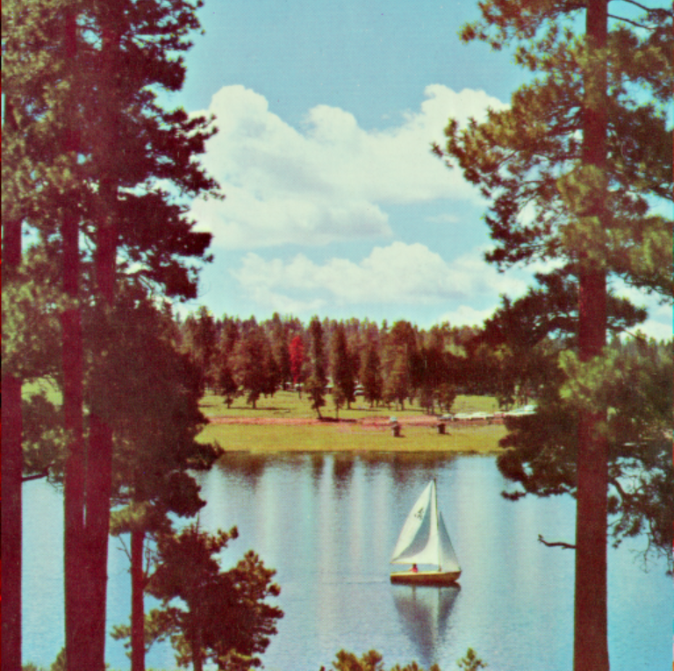
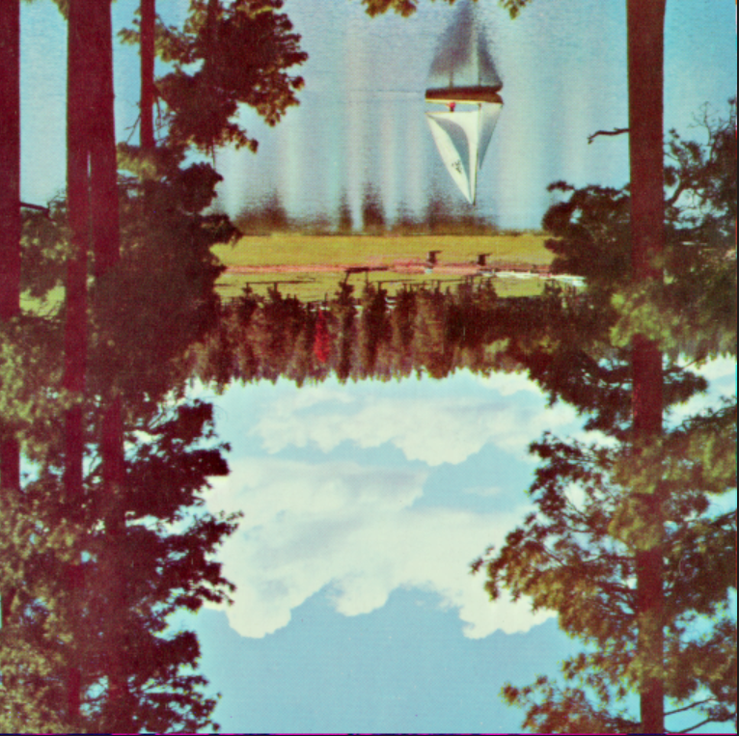
Output: water image

Slide 6
2)MIRROR image
Syntax : ./final –r m threshold input.ppm output.ppm
TOP-LEFT
TOP-RIGHT
TR
TL
BOTTOM-LEFT
BOTTOM-RIGHT
BR
BL

Slide 7
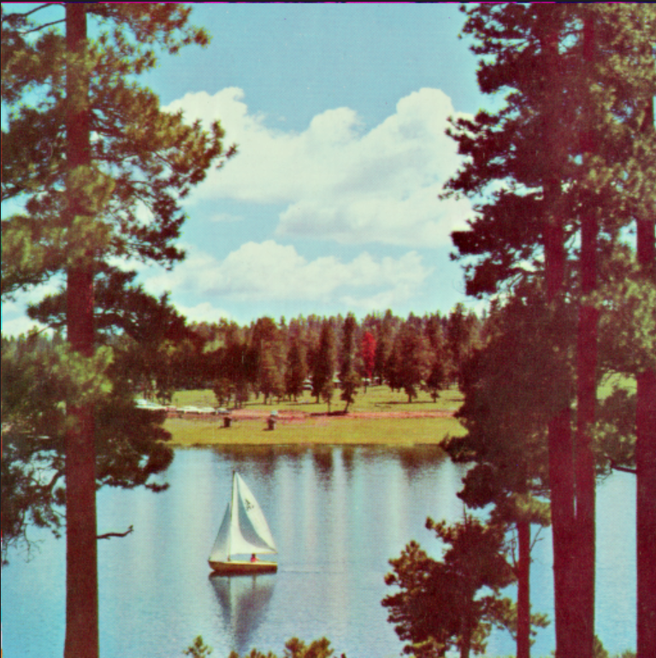
Output: mirror image

Slide 8
3)ROTATE image LEFT BY 90 DEGREES
Syntax : ./final –r l90 threshold input.ppm output.ppm
TOP-LEFT
TOP-RIGHT
TR
BR
BOTTOM-LEFT
BOTTOM-RIGHT
TL
BL

Slide 9
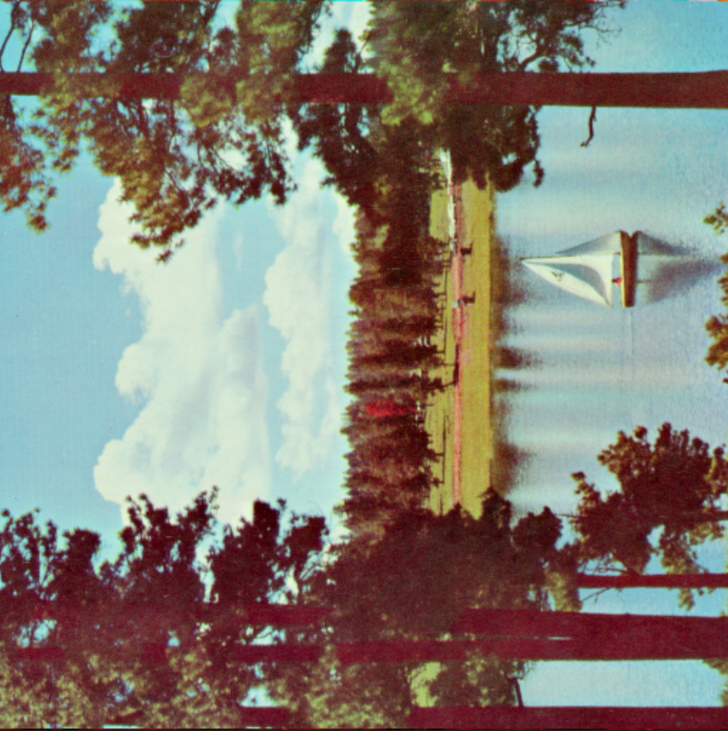
Output: rotate image left by 90 degrees

Slide 10
4)ROTATE image RIGHT BY 90 DEGREES
Syntax : ./final –r r90 threshold input.ppm output.ppm
TOP-LEFT
TOP-RIGHT
BL
TL
BOTTOM-LEFT
BOTTOM-RIGHT
BR
TR

Slide 11
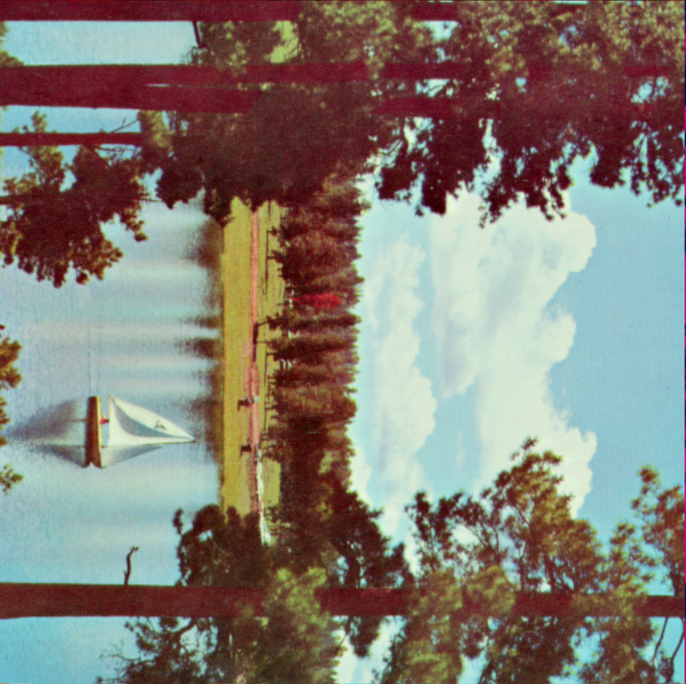
Output: rotate image right by 90 degrees

Slide 12
5) GRAYSCALE ImaGE
Syntax : ./final –g threshold input.ppm output.ppm
Recursively go to each pixel of a qt and change each pixel such that red=0.3*red, green=0.59* green, blue=0.11* blue.
TOP-LEFT
TOP-RIGHT
TL
TR
BOTTOM-LEFT
BOTTOM-RIGHT
BL
BR

Slide 13
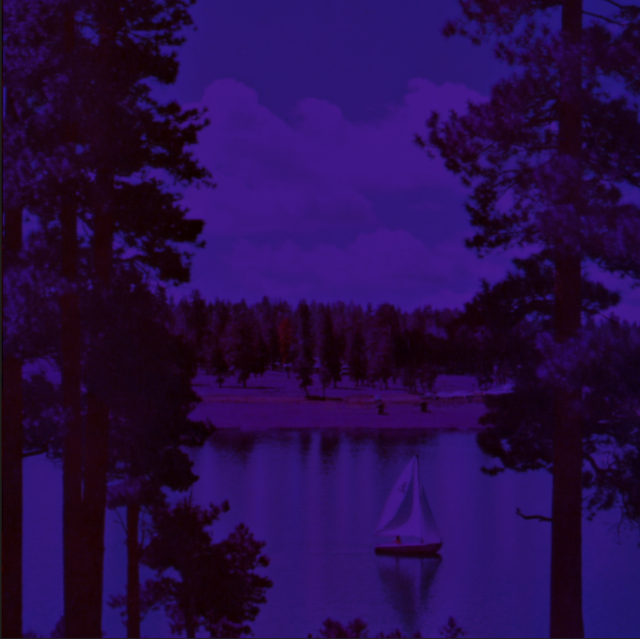
Output: grayscale image

Slide 14
6) negative ImaGE
Syntax : ./final –n threshold input.ppm output.ppm
Recursively go to each pixel of a qt and change each pixel such that red=255-red, green=255-green, blue=255- blue.
TOP-LEFT
TOP-RIGHT
TL
TR
BOTTOM-LEFT
BOTTOM-RIGHT
BL
BR

Slide 15
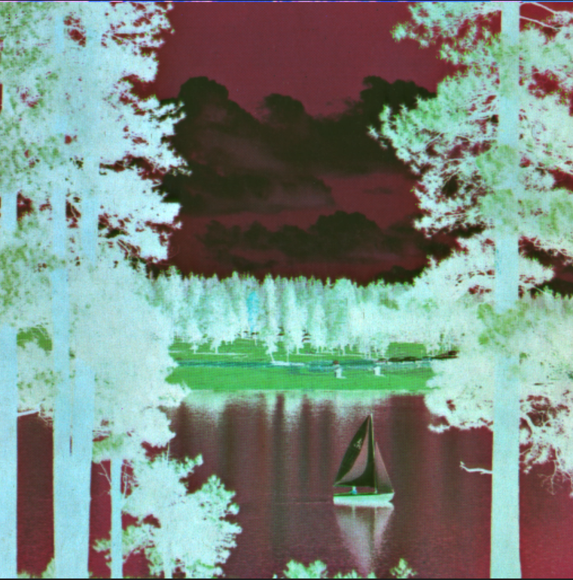
Output: negative image

Slide 16
7) sepia ImaGE
Syntax : ./final –s threshold input.ppm output.ppm
Recursively go to each pixel of a qt and change each pixel.
TOP-LEFT
TOP-RIGHT
TL
TR
BOTTOM-LEFT
BOTTOM-RIGHT
BL
BR

Slide 17
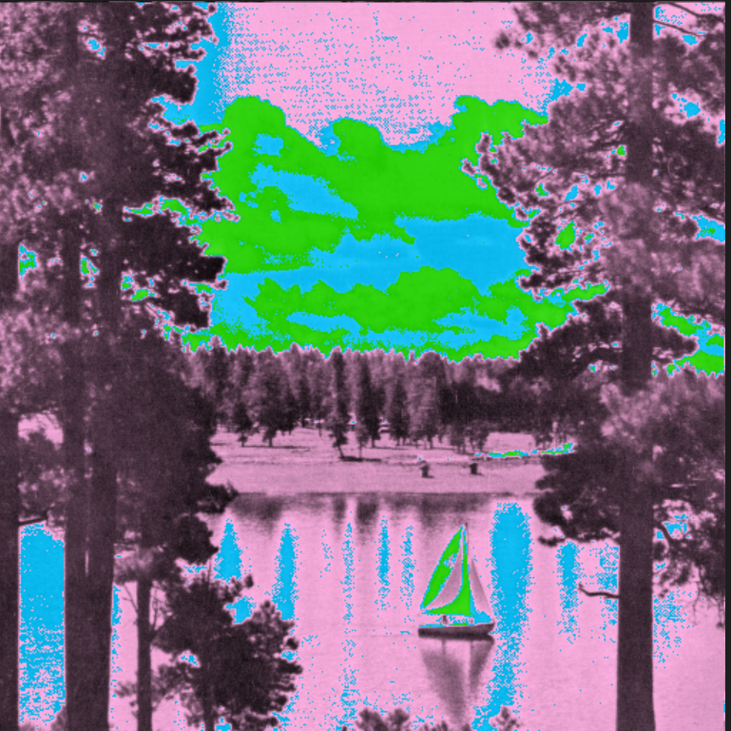
Output: sepia image

Slide 18
9) Union of two ImaGEs
Syntax : ./final –u threshold input1.ppm input2.ppm output.ppm
Recursively traverse both the quadtrees containing information about the pixels such that both of them combine to form a new overlapped image.

Slide 19

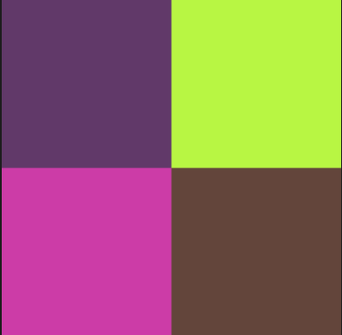

Output: union of two images

Slide 20
references
Image Manipulation Using Quadtrees – GeeksforGeeks
quadtrees-paper.pdf (carleton.ca)
Quadtree-based processing of digital images (pdx.edu)
Quadtrees for Image Compression. A visual look into how and why… | by Tanner York | Medium

